Slide 1

Molecular Dynamic guided Machine learning model for Predicting the thermo-mechanical properties of Silicon-Carbide
M.Saravan Vyaas
P.S.V Shashank
P.Deva Kumar
Department of Mechanical Engineering
Machine Learning for materials informatics (MLMI)

Slide 2

Silicon Carbide(SiC)
Properties
High Thermal Conductivity
High Elastic Modulus
High Hardness
Low Thermal Expansion Coefficient
High Temperature Strength and Stability
Tetrahedron Structure
Notes:
Why you studying this materials

Slide 3



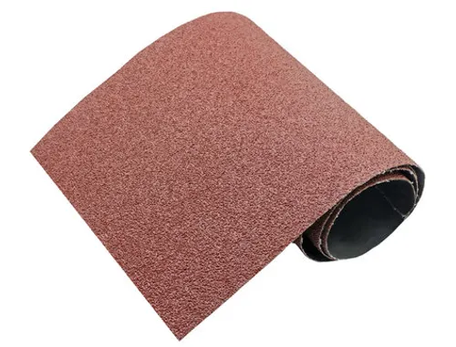
Silicon Carbide(SiC)-Uses
EV Inverters
Solar Industry
Ceramics
Sand paper
Powers inverters, enhancing battery efficiency and driving range significantly.
Converts DC to AC efficiently in renewable energy power setups.
Adds strength and temperature resistance to industrial ceramic components.
Adds strength and temperature resistance to industrial ceramic components.

Slide 4

Objective
To develop and validate a machine learning model capable of accurately predicting the thermomechanical properties of Silicon Carbide (SiC) under various temperatures and strains.
Generate Dataset from MD simulation using LAMMPS input script
Building a Regression model, preprocessing the data with PolynomialFeatures to capture non-linear physical relationships.

Slide 5
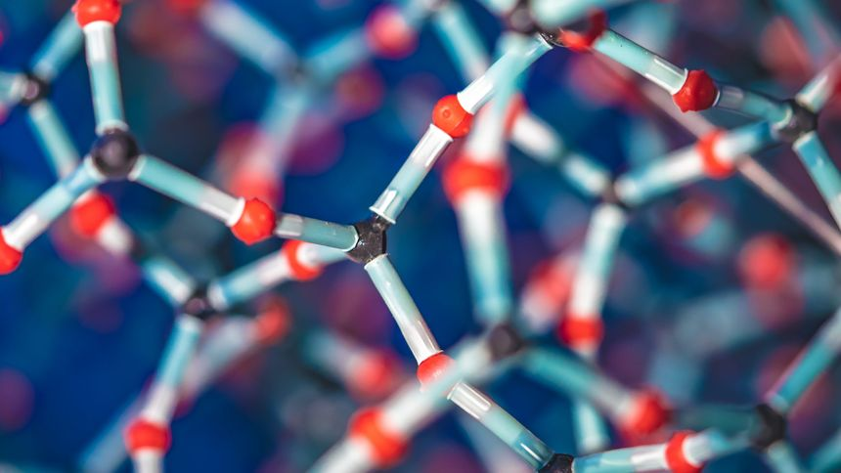
Target Material Properties
Thermal Conductivity(WmK)
  The thermal conductivity of a material is a measure of its ability to conduct heat
Stress(Pa)
  Pressure or tension exerted on a material object
Young’s Modulus
  A measure of elasticity, equal to the ratio of the stress acting on a substance to the strain produced.

Slide 6
Process Flow
MD simulation in LAMMPS
Examining Properties
Property Prediction
Data acquisition
Model Training
In Python
Validation of Data

Slide 7
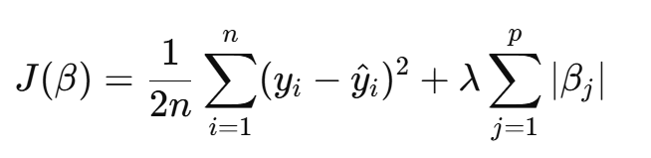
Selected Model
LASSO Regression
It’s a type of regression which is used to reduce overfitting
It adds a penalty base on the sum of the absolute values of the coefficients
It tries to minimize the Mean Squared Error (MSE), just like a normal regression model.
Hyperparameters used: λ & βj​
https://www.appliedaicourse.com/blog/lasso-regression/

Slide 8
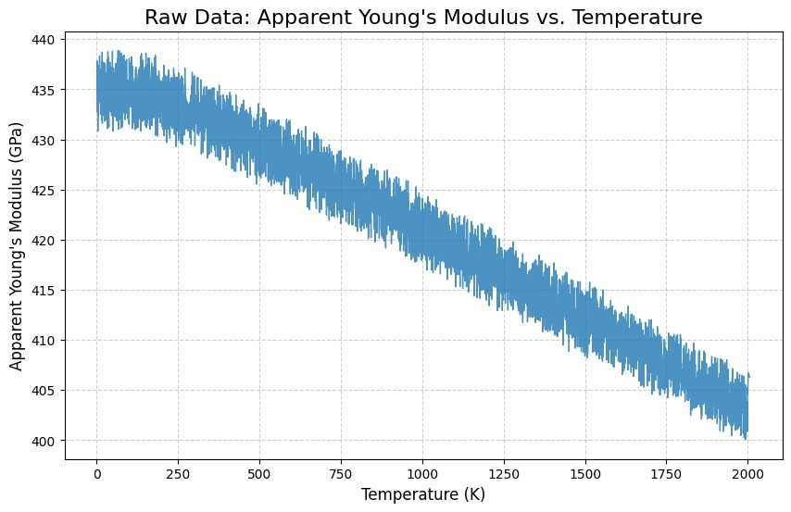
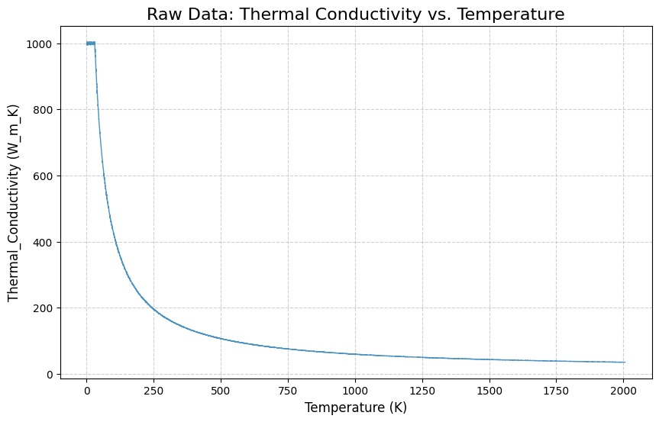
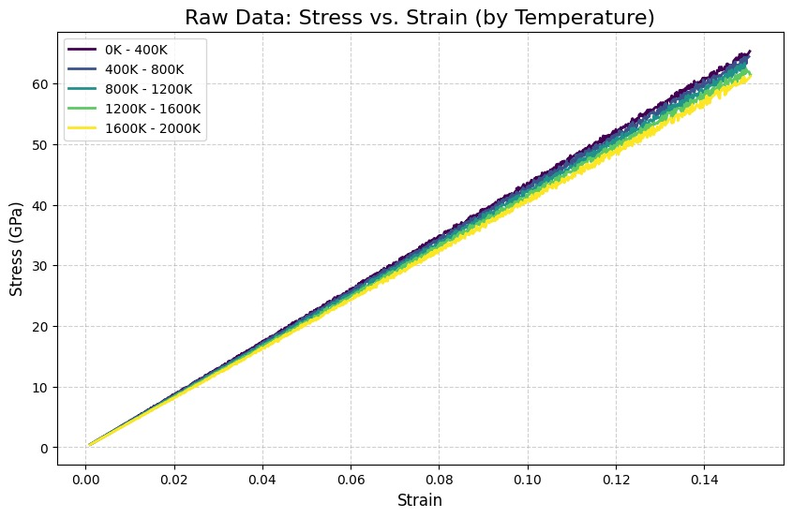
Visualising Raw Data
Apparent Young’s Modulus VS T
Thermal Conductivity VS T
Stress VS Strain

Slide 9
Model Training
Data Splitting
70 % Training And 30 % Testing
Hyperparameter λ =1.0 for training.
Metrics used = Mean square error,R^2.
Data | R^2 Score | MSE
Train | 0.77 | 5374.052
Test | 0.78 | 5834.97

Slide 10
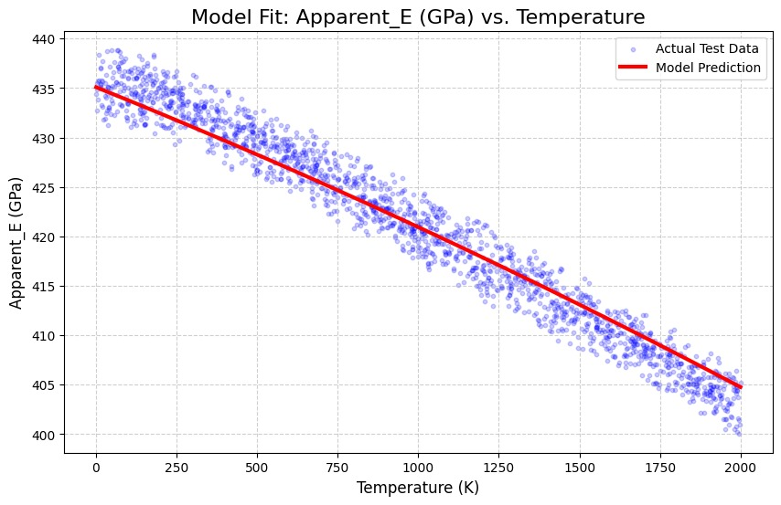
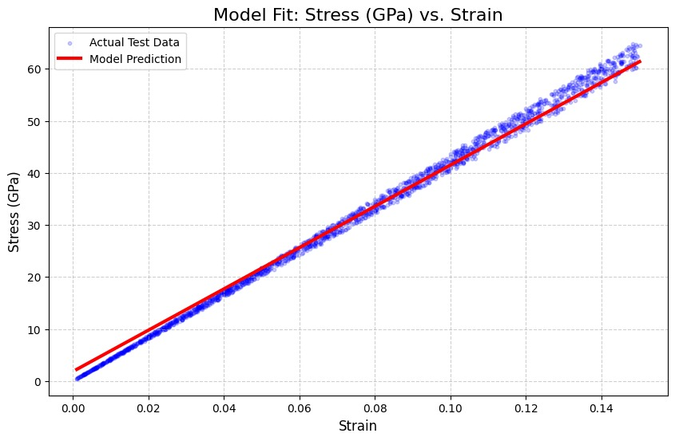
Property Prediction & Validation
Actual VS Predicted Values

Slide 11
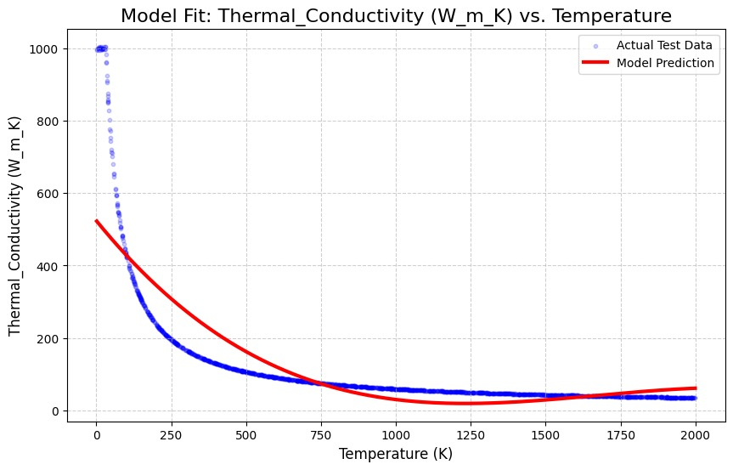

Slide 12
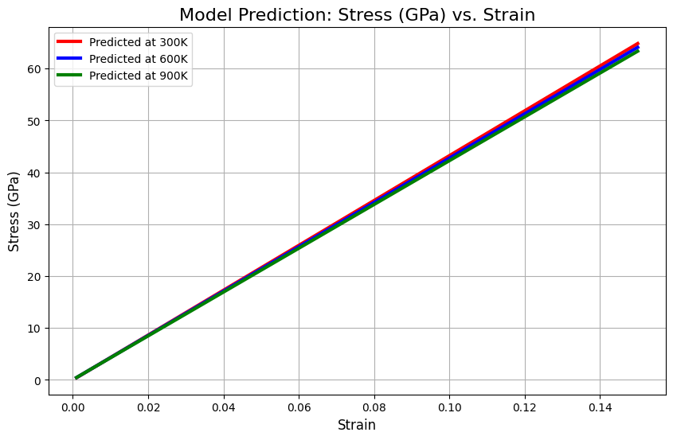
Results

Slide 13
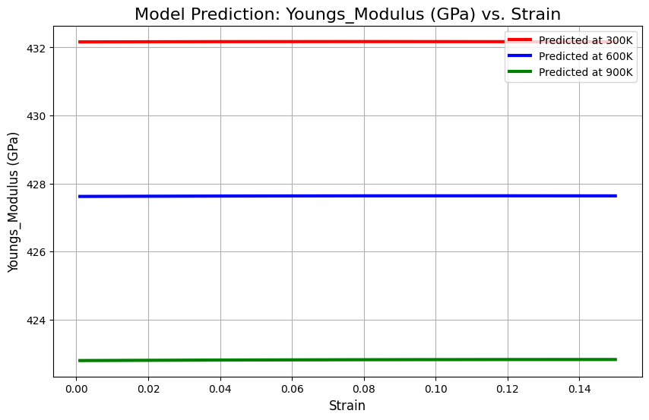
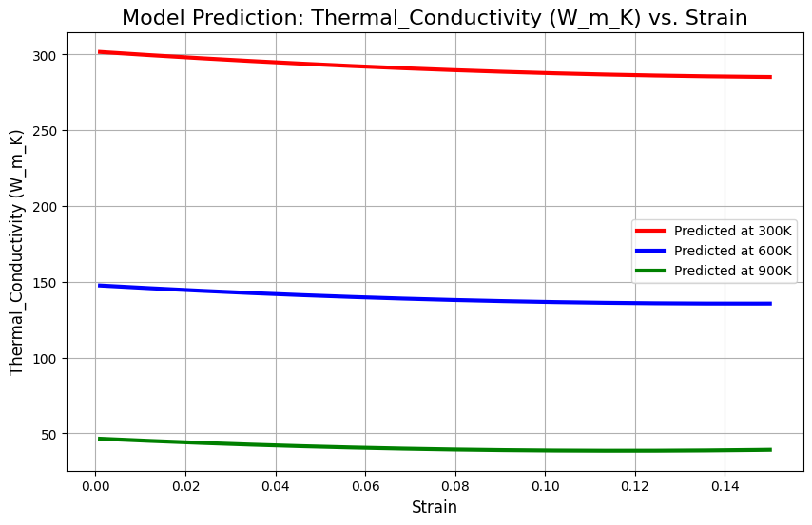
Results

Slide 14

Conclusions
To bridge the gap between computationally-intensive MD simulations and the need for rapid material analysis, a novel machine learning model is proposed, developed on a large set of 6,000 simulated data points.
We constructed a Lasso Regression model to investigate the thermomechanical properties of Silicon Carbide (SiC), examining how properties like Stress and Young's Modulus vary with Temperature and Strain.
The results from the trained Lasso model, when validated against a 30% hold-out test set, show strong predictive accuracy and are consistent with the underlying physical trends for properties such as Young's Modulus, Stress (GPa), and Thermal Conductivity.

